Slide 1


Slide 2

There is wide diversity in the hours per week that people choose to work.
Let,
There are 168 hours in a week, and each individual decides how to allocate those hours among various activities.
Fixed Biological needs for sleeping, eating, and so on require 68 hours.
Remaining 100 hours can be divided either into labor (work) or leisure. This time is discretionary for the individual.

Slide 3
Work is all hours devoted to a paying job whereas leisure is the remainder of time used for all other activities like nonmarket activities as watching movie, going to school, or working in the home.
The theory predicts that if the income should increase, the demand for the good will increase, it is what economists call a normal goods.
Leisure is a normal good.

Slide 4
Preference and Indifference Curves:
Preference represent an individual’s psychological feelings or perceptions about an item’s desirability vis-à-vis other goods or services. They are inherently subjectively in nature and potentially influenced by a host of factors related to one’s ethnicity, socioeconomic class, and occupation, as well as individual personality factors.
Individuals have to rank and choose between two goods: Leisure and Work (Income earned from).
Leisure is desired for its own intrinsic qualities, and income is desired for the goods and services it can buy.

Slide 5
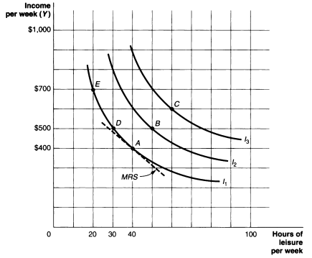
Preference and Indifference Curves:

Slide 6
Properties of Indifference curves:
First, they have negative sloped- i.e. the slope down and to the right.
Second, the indifference curves are convex to the origin.
This convex shape reflects what economist call a diminishing marginal rate of substitution (MRS). The MRS measures the rate at which a person is willing to trade income for leisure; a diminishing MRS implies that a person will give up successive units of leisure only in exchange for larger and larger increment of income, and vice versa.

Slide 7

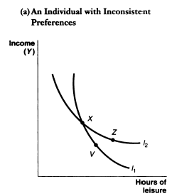
Properties of Indifference curves:
Third, Higher indifference curve shows higher level of satisfaction.
Forth, they never intersect or cross each other for any one person, at any one point in time.
X I Z
V I X
Z I V

Slide 8
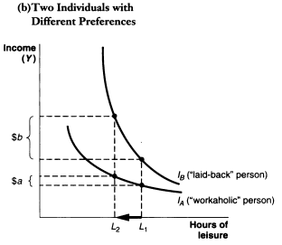
Properties of Indifference curves:
Finally, their shape (slope and degree of convexity) differs for each individual, to the extent that people have different preferences or attitudes regarding the desirability of work versus leisure.

Slide 9

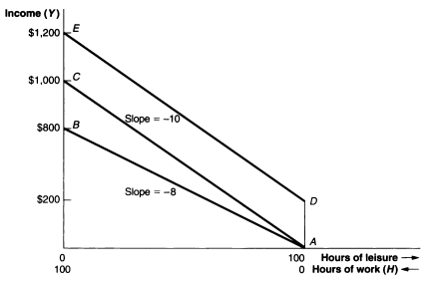
Wages, Income, and the Budget Constraint:
The demand for a good or service is shaped not only by preferences, but also by economic factors such as price and income. The opportunity cost of an hour of leisure, therefore, is equal to wage rate per hour of work. The higher the wage is, the higher is the price of leisure.

Slide 10
Properties of Budget Constraint:
Its slope is negative, i.e. income falls as hours of leisure rise.
The slope of BC equals the negative of the wage rate. Here slope= -8, the amount of income lost for each extra hour of leisure.
A change in the
wage rate rotates the
BC, making it steeper
for a rise in the wage
and flatter for a fall
in the wage.

Slide 11
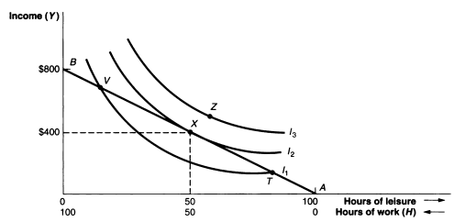
Equilibrium hours of work:
Slope of BC, Wage rete = W; Slope of IC= MRS
At equilibrium, W= MRS

Slide 12

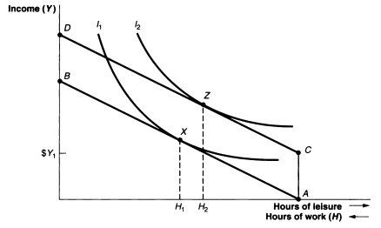
Hours of work and Changes in Non-labor Income:
Income Effect: The changes in hours of work (∆H) resulting from a change in income (∆Y), keeping the wage rate constant (W). If leisure is a normal good, the sign of the income effect must be negative:

Slide 13

Hours of work and Changes in Wage Rate:
Substitution Effect: When the price of leisure increases, the demand for leisure should decline, causing an individual to work more hours per week.
A wage change can cause two following events:
Either increased hours of work,
Or, decreased hours of work

Slide 14
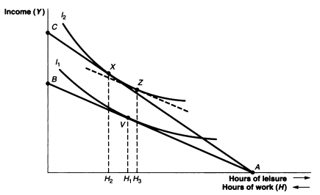
Hours of work and Changes in Wage Rate:
A wage change leading to increased hours of work:

Slide 15
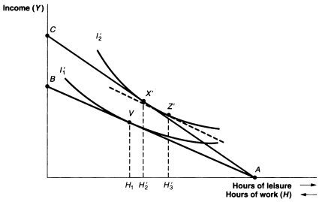
Hours of work and Changes in Wage Rate:
A wage change leading to decreased hours of work:

Slide 16
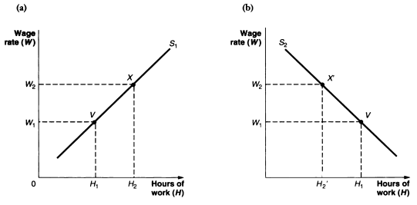
A positively and negatively sloped labor supply curve:

Slide 17
Backward-bending labor supply curve:
A backward-bending supply curve is positively sloped at low wage rates [S.E> I.E] but negatively sloped at high wage rates [I.E> S.E].
Wage rate(w)
0 Hours of Work (H)

Slide 18

Three important assumptions of the neoclassical Labor/Leisure model are frequently violated in the real world:
Frist: Fixed work schedule mandated by employers.
Second: The existence of time and money cost of working.
Third: Employees who are paid a lump-sum salary rather than a wage per hour.

Slide 19
Frist: Employers mandated work Schedule:
The labor/ leisure model emphasizes the role of individual choice as major determinant of work hours. However, in real world, the employers preferences and fixed work schedules violate the model.
Employers set work schedules represent an institutional constraint on individual choice that may prevent some workers from reaching their most preferred combination of hours of work and leisure.

Slide 20
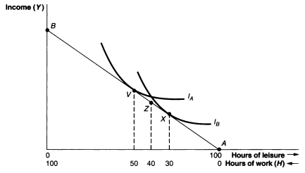
Frist: Employers mandated work Schedule:

Slide 21
Frist: Employers mandated work Schedule:
From the diagram, it is observed that individual A is made worse off because he or she desires to work longer hours and would willingly sacrifice 10 more hours of leisure to obtain the additional income.
Person B is also made worse off, but for the opposite reason, since he or she would gladly sacrifice some income to have 10 more hours of leisure.
In this circumstances, both individuals have sever options to change his or her utility at the desired level.

Slide 22
Frist: Employers mandated work Schedule:
For Individual A,
To find a new occupation that allows flexibility in working hours. Flexible hours are particularly important for working women with children.
Person A is to moonlight by taking second job.
For Individual B,
Absenteeism.
Through the threat of strike they could induce the firm to change the work schedule toward that preferred by the workers.

Slide 23

Second: The existence of time and money cost of working.
The labor/ leisure model assumes that every hour not spent consuming leisure translates into an income-generating work activity.
In reality, a decision to work 40 hours per week, for example, likely means that leisure is reduced by more than 40 hours; it takes time to get to and from work.
In addition, total income does not likely increase, but the worker incurs some monetary costs associated working such as hourly child care costs and/ or monthly parking fees.

Slide 24
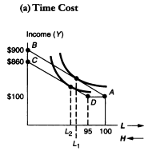
2 (a).Fixed time Costs: In the absence of any costs of working, and given a wage rate of $8 per hour, the budget constraint is AB. If takes someone 30 minutes to get to work, total amount of time available for working is reduced to 95 hours per week.

Slide 25
2 (a).Fixed time Costs: A leftward shift of budget constraint observed due to the increase in the fixed costs, and the demand for leisure will reduce further (I.E.).
If the difference between L2 and L1 in the diagram is less than 5 hours, then actual hours have decreased,i.e.95-L2 <100-L1.
If the difference between
L2 and L1 in the diagram
is greater than 5 hours,
then actual hours have
increased, i.e. 95-L2 >100-L1.

Slide 26
y
900
860
100
0 L2 L1 95 100 L→
100 0 H ←

Slide 27

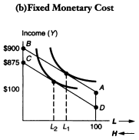
2 (b).Fixed monetary Costs: Monetary costs can be fixed like a lump-sump cost incurred each time one goes to work such as a parking fee. If the employee faces a weekly fixed cost of $25 for parking, for instance, the budget constraint becomes line ADC.

Slide 28
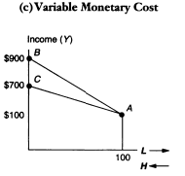
2 (c).Variable monetary Costs: Monetary cost can be variable e.g. a per-hour cost whose total increases with the number of hours worked, such as child care. If this person faces a $2 per hour fee for child care, his or her income decreases to $6 for every hour worked. Here desire hour of work may increase or decrease whether the income or substitution effect is stronger.

Slide 29
Third: Employees who are paid a lump-sum salary rather than a wage per hour.
Salaried workers are most likely to be employed in white-collar occupations, particularly professional employees such as lawyers, engineers, and teachers as well as persons in a wide range of managerial occupations. The main difference between the hourly worker and salaried workers is the budget constraint.
For hourly workers, budget Constraint is AB and the Slope is W1 which shows the marginal change in income for each additional hour worked. Therefore, the range of income will be 0 to $Wx100= YH

Slide 30
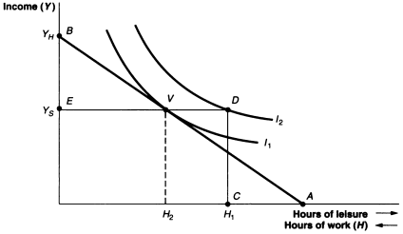
Third: Employees who are paid a lump-sum salary rather than a wage per hour.
Salaried workers face a right-angle line CDE. Here, below H1 hours of work per week the individual will be fired by the employer, and earning would be zero. At this level of work, they receive Ys salary.
Income is invariant
Above H1 hours
And marginal wage
rate is zero.

Slide 31

In progressive income tax, the marginal tax rate, t, increases with the level of earnings.
Without income tax, the wage rate is assumed as W1 and with zero non-labor income the budget constraint is AB.
If progressive income tax is imposed at a rate t, the net income received by the employee now-
W1 - t W1 = (1-t)W1
The effect of income tax, then, is to give rise to the new, curved budget constraint AC.

Slide 32

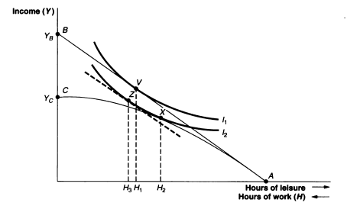

Slide 33
Questions: Use the labor/ leisure model to analyze the effect on hours of work of a law requiring employers to pay time and a half for hours of worked over 40 per week.
a.) First draw a budget constraint for someone earning $8 per hour who receives $100 a week in non-labor income. What now happens to the budget constraint with the time-and-a-half requirement.

Slide 34
Question:
b.) Given your answer to (a), draw an indifference curve so that, given the original budget constraint, the person is working 40 hours per week. What now happens to hours of work given the new budget constraint? Draw an indifference curve to show this. Have hours of work increased or decreased as a result of the overtime law? Explain why.
c.) In words, define the income and substitution effects. Next, use the graph to identify the income and substitution effects. Which is stronger?

Slide 35
Question:
d.) If the wage had been increased for all hours worked rather than just for those after 40 per week, would the change in hours of work be any different? Show this in the graph and explain why or why not.

